Slide 1
Journal Club: MLPs
Equivariant Graph Neural Networks
August 20, 2025

Slide 2
Behler-Parrinello Neural Networks
DeePMD
NequIP*
2007
2018
2022

Slide 3
Behler-Parrinello Neural Networks
DeePMD
NequIP*
2007
2018
2022
PhysNet
Tensor Field Networks
2020
2017
DimeNet
SchNet

Slide 4
Behler-Parrinello Neural Networks
DeePMD
NequIP*
2007
2018
2022
PhysNet
Tensor Field Networks
2020
2017
DimeNet
SchNet
Both
Graph Neural Networks
Equivariant Neural Networks

Slide 5
Graph Neural Networks

Slide 6
Graph Neural Networks
Purpose: A solution to arbitrary representations of local atomic environments.

Slide 7
Graph Neural Networks
Purpose: A solution to arbitrary representations of local atomic environments.

Slide 8
Graph Neural Networks
Purpose: A solution to arbitrary representations of local atomic environments.

Slide 9
Graph Neural Networks
Purpose: A solution to arbitrary representations of local atomic environments.

Slide 10
Graph Neural Networks
Purpose: A solution to arbitrary representations of local atomic environments.
Learned Atomic Environment Representation

Slide 11
How do we apply a neural network to a graph?

Slide 12
How do we apply a neural network to a graph?

Slide 13
How do we apply a neural network to a graph?

Slide 14
How do we apply a neural network to a graph?
Neighbor #1
Neighbor #2

Slide 15
How do we apply a neural network to a graph?
Neighbor #1
Neighbor #2
Message #1
Message #2

Slide 16
How do we apply a neural network to a graph?
Neighbor #1
Neighbor #2
Message #1
Message #2

Slide 17
How do we apply a neural network to a graph?
Neighbor #1
Neighbor #2
Message #1
Message #2
Update #1
Update #2

Slide 18
How do we apply a neural network to a graph?
Neighbor #1
Neighbor #2
Message #1
Message #2
+
+
=
Update #1
Update #2

Slide 19
How do we apply a neural network to a graph?

Slide 20
How do we apply a neural network to a graph?

Slide 21
How do we apply a neural network to a graph?
+
Learned Atomic Environment Representation

Slide 22
Graph Neural Networks
Purpose: A solution to arbitrary representations of local atomic environments.
Learned Atomic Environment Representation

Slide 23
Graph Neural Networks
Purpose: A solution to arbitrary representations of local atomic environments.
Key Takeaways:
GNNs learn atomic environment representations from data.
GNNs perform graph operations that update node and edge representations.
Learned Atomic Environment Representation

Slide 24
Equivariant Graph Neural Networks
Purpose: Restrict node representations and node updates to obey physical symmetries present in Euclidean space.

Slide 25
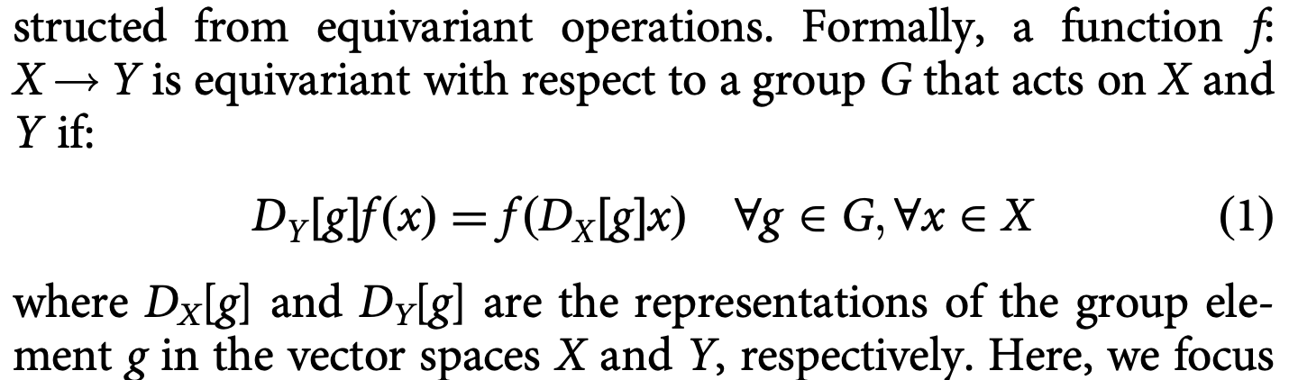
Equivariant Graph Neural Networks
Purpose: Restrict node representations and node updates to obey physical symmetries present in Euclidean space.
"...the network contains internal features that are geometric tensors which are equivariant to rotation and reflection."

Slide 26
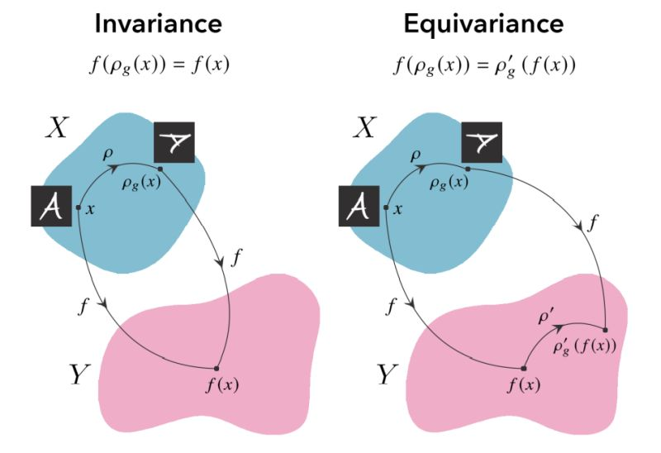
Equivariant Graph Neural Networks
Purpose: Restrict node representations and node updates to obey physical symmetries present in Euclidean space.
"...the network contains internal features that are geometric tensors which are equivariant to rotation and reflection."

Slide 27
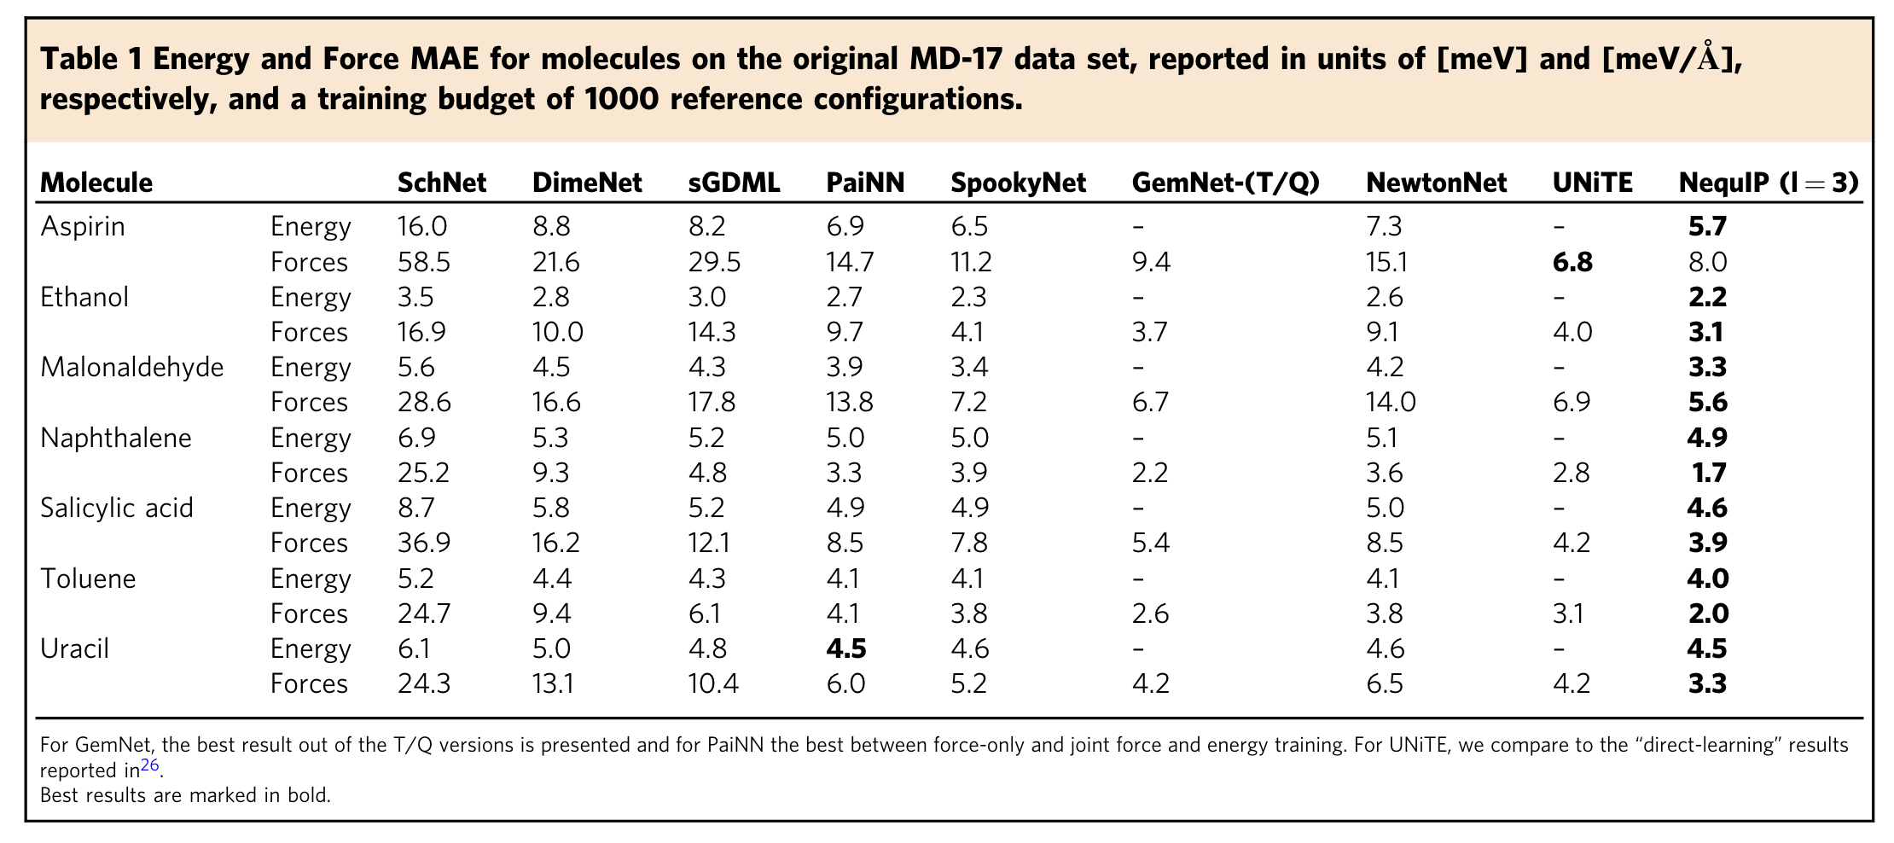
Results: Small Molecule Energy and Force Prediction

Slide 28
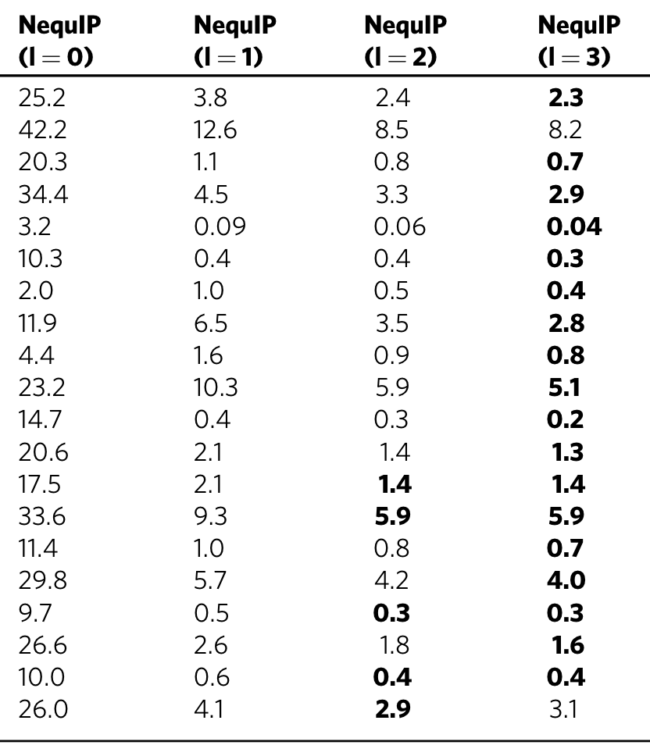
Results: Small Molecule Energy and Force Prediction

Slide 29
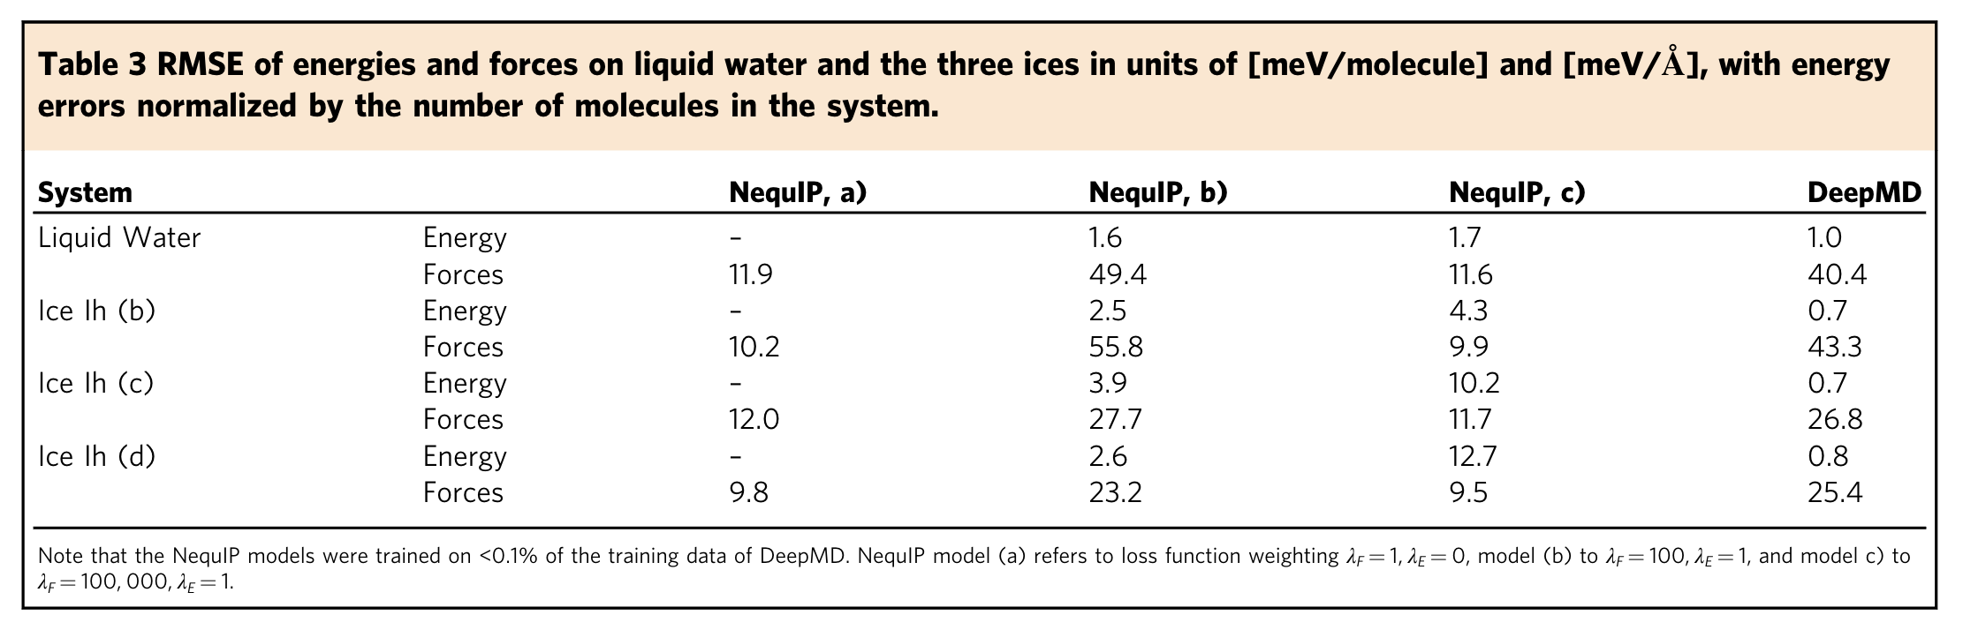
Results: Comparison to DeePMD on Water/Ice

Slide 30
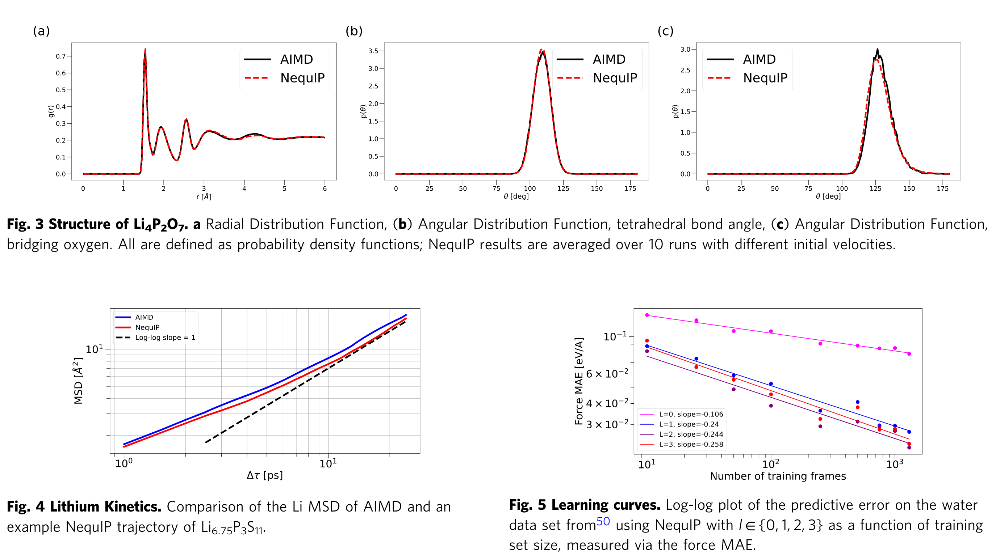
Results: NequIP is accurate and data-efficient.

Slide 31
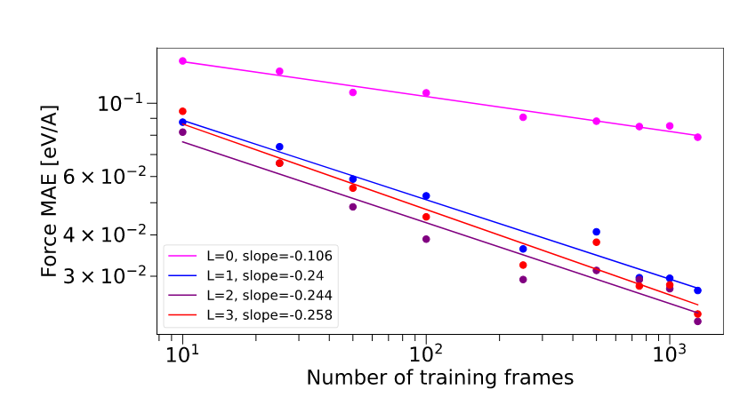
Results: The Impact of Equivariance

Slide 32
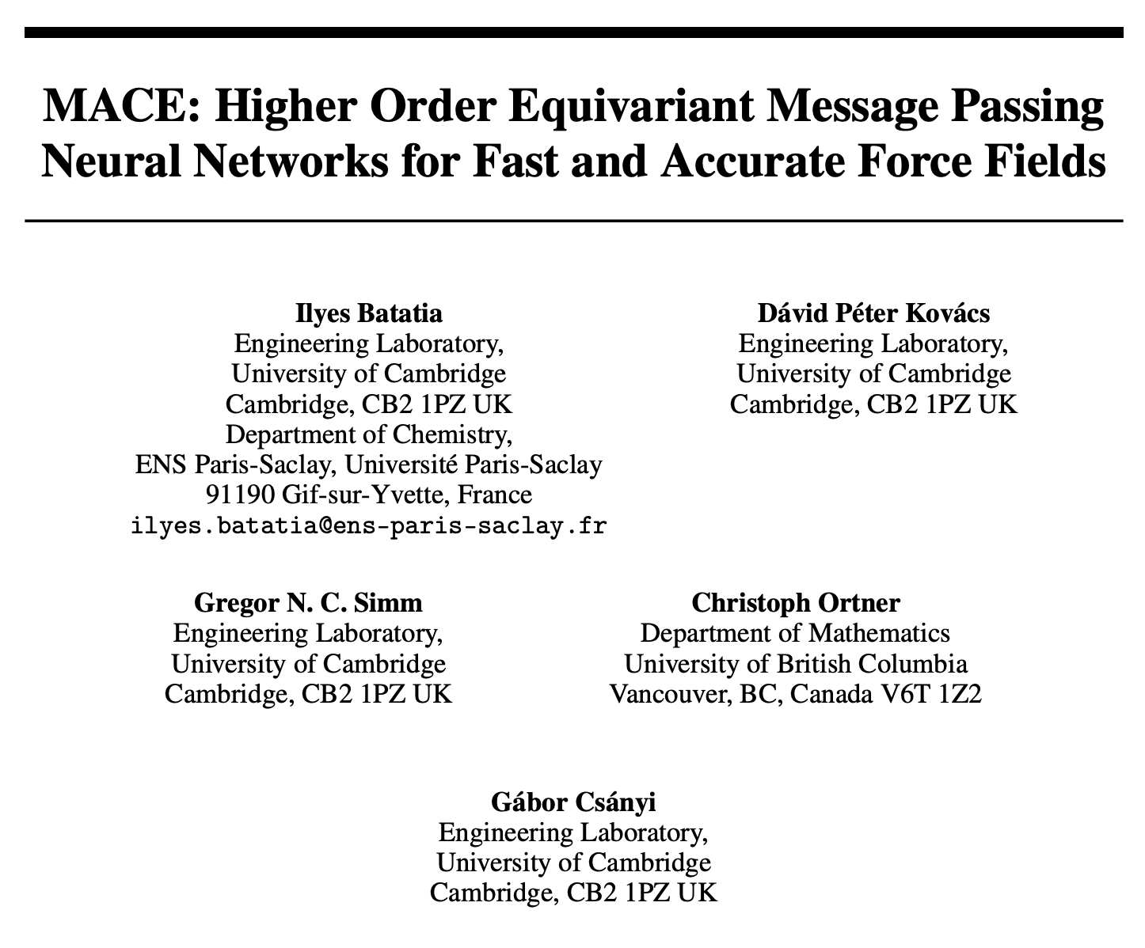
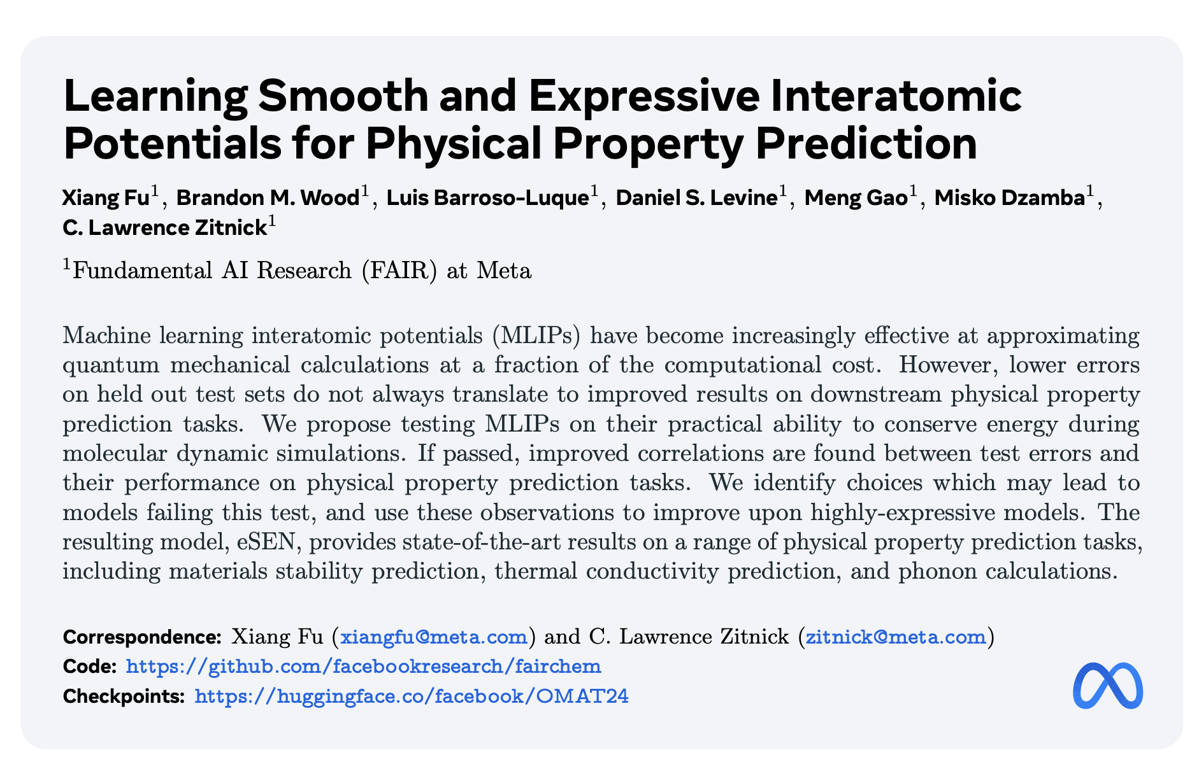
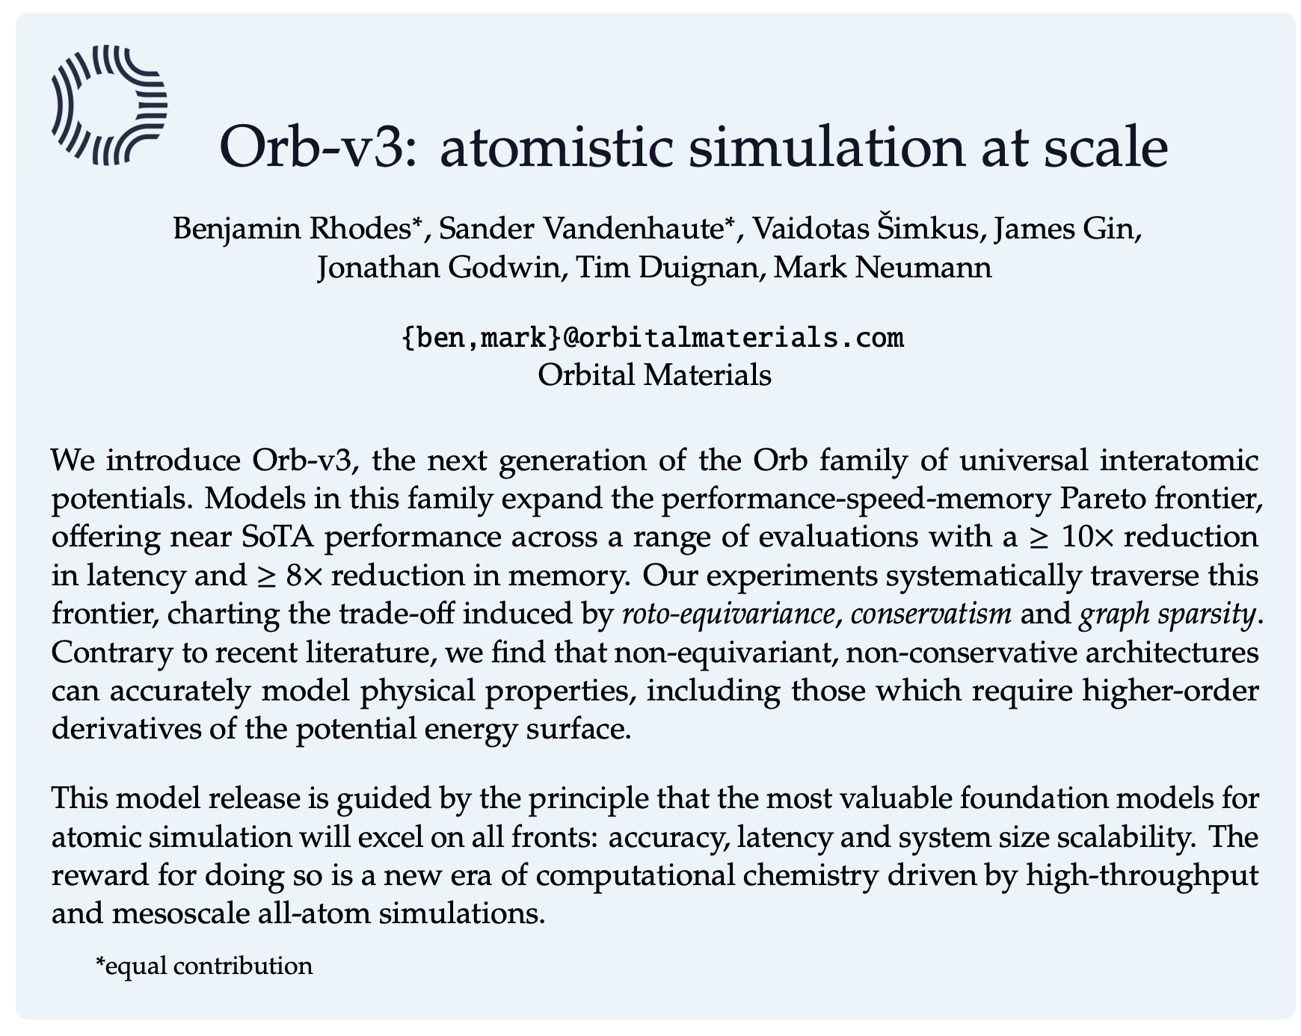
The Popularity of Equivariant Graph Neural Networks
MACE
eSEN
Orb-v3*
Equivariance is commonly employed by architectures used for training universal MLPs!

Slide 33
Equivariant Graph Neural Networks
How do equivariant GNNs (NequIP) actually work?

Slide 34
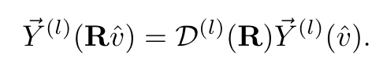
Equivariant Graph Neural Networks
How do equivariant GNNs (NequIP) actually work?
Preliminary: Spherical harmonics are rotationally equivariant basis functions.
Wigner D-Matrix Coefficients

Slide 35
Equivariant Graph Neural Networks
How do equivariant GNNs (NequIP) actually work?
Preliminary: Tensor products preserve equivariance.

Slide 36
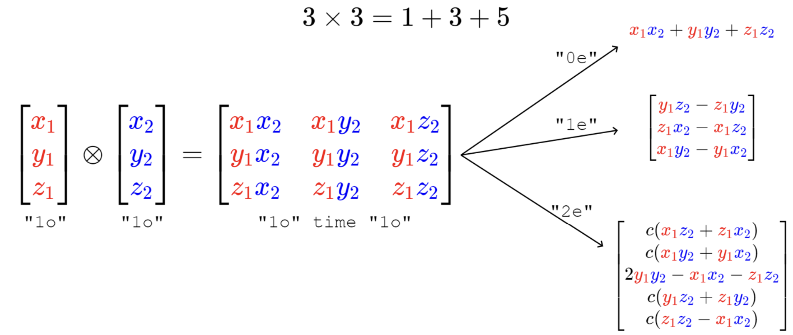
Tensor Product
L = 0
L = 1
L = 2
Tensor type / rotation order L groups tensors by how they would respond to a rotation.

Slide 37
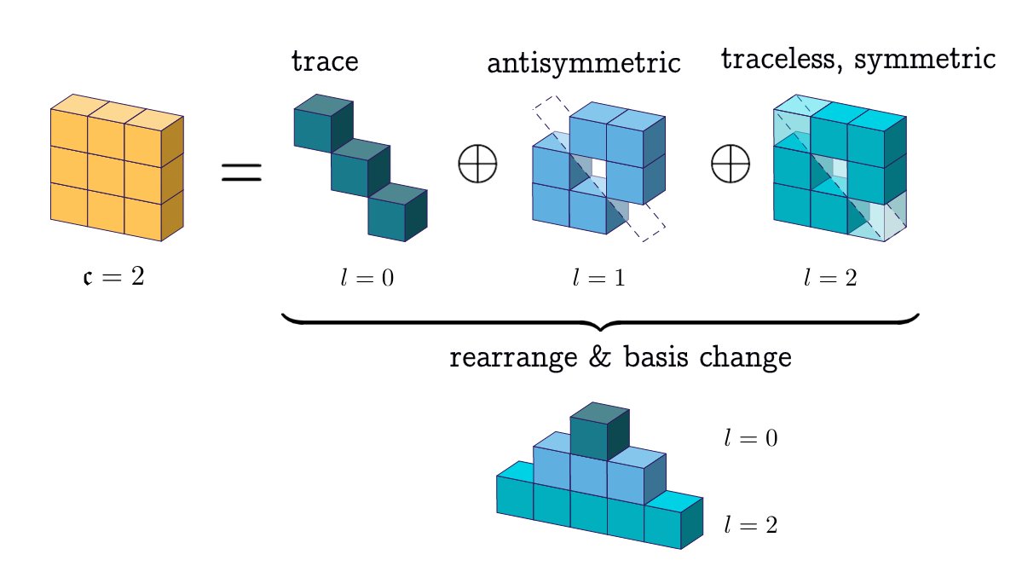
Equivariant Graph Neural Networks
How do equivariant GNNs (NequIP) actually work?
Preliminary: Tensor products preserve equivariance.

Slide 38
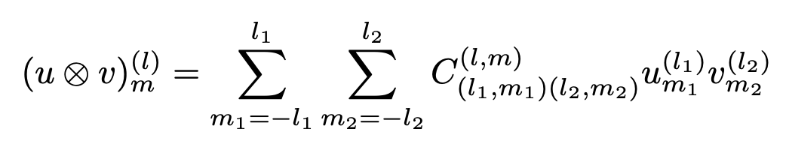
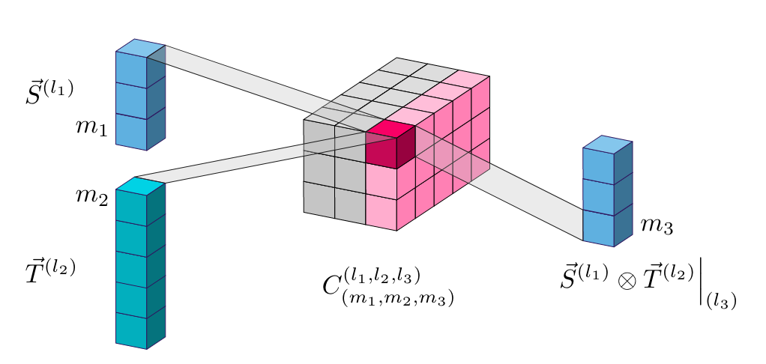
Equivariant Graph Neural Networks
Preliminary: Clebsch-Gordon coefficients specify how tensor components of different types should be combined.

Slide 39
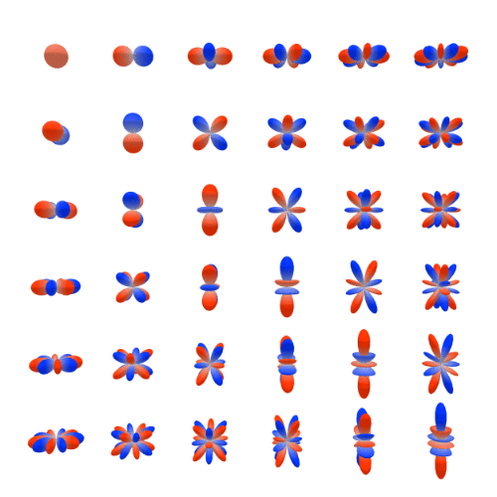
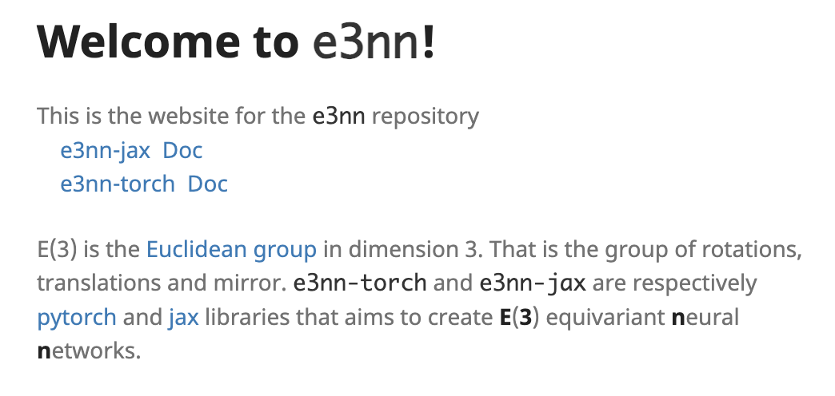
Equivariant Graph Neural Networks
The e3nn Python package implements tensor product computations.

Slide 40
Equivariant Graph Neural Networks
How do equivariant GNNs (NequIP) actually work?

Slide 41
Equivariant Graph Neural Networks
How do equivariant GNNs (NequIP) actually work?
Initially, node features are embeddings of atomic number.
Initially, edge features are displacement vectors between nodes i and j.

Slide 42
Equivariant Graph Neural Networks
How do equivariant GNNs (NequIP) actually work?
Node features
Edge features

Slide 43
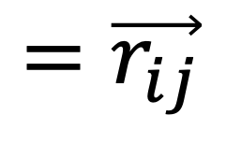
Equivariant Graph Neural Networks
How do equivariant GNNs (NequIP) actually work?
$$=\vec{r_{ij}}$$
Node features
Edge features

Slide 44
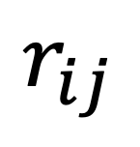
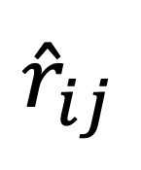
Equivariant Graph Neural Networks
How do equivariant GNNs (NequIP) actually work?
$$=\vec{r_{ij}}$$
$$r_{ij}$$
and
$${\hat{r}}_{ij}$$
Node features
Edge features
Distance
Unit vector

Slide 45

Equivariant Graph Neural Networks
How do equivariant GNNs (NequIP) actually work?
$$=\vec{r_{ij}}$$
$$r_{ij}$$
and
$${\hat{r}}_{ij}$$
Node features
Edge features
Distance
Unit vector

Slide 46
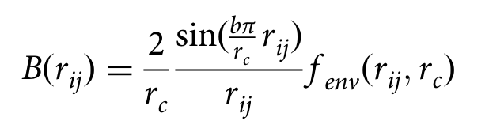
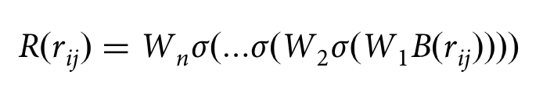
Equivariant Graph Neural Networks
How do equivariant GNNs (NequIP) actually work?
$$=\vec{r_{ij}}$$
$$r_{ij}$$
and
$${\hat{r}}_{ij}$$
Node features
Edge features
Distance
Unit vector
1
Represent distance using b Bessel function evaluations.
Pass the distance representation through a neural network.
2

Slide 47
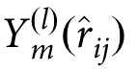

Equivariant Graph Neural Networks
How do equivariant GNNs (NequIP) actually work?
$$=\vec{r_{ij}}$$
$$r_{ij}$$
and
$${\hat{r}}_{ij}$$
Node features
Edge features
Distance
Unit vector
Represent unit vector using a specified number of spherical harmonic basis functions.
1

Slide 48
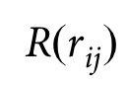
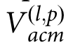
Equivariant Graph Neural Networks
How do equivariant GNNs (NequIP) actually work?
Node features
Edge features

Slide 49
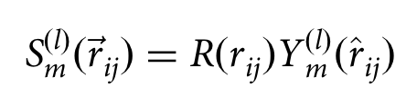
Equivariant Graph Neural Networks
How do equivariant GNNs (NequIP) actually work?
Node features
Edge features
1
We produce convolutional filters by taking products of the edge features.

Slide 50
Equivariant Graph Neural Networks
How do equivariant GNNs (NequIP) actually work?
Node features
Edge features
1
We produce convolutional filters by taking products of the edge features.
2
We combine node features and convolutional filters using tensor products.

Slide 51
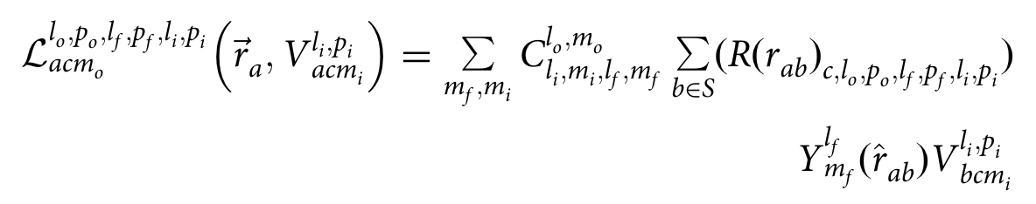
Equivariant Graph Neural Networks
How do equivariant GNNs (NequIP) actually work?
Node features
Edge features
1
We produce convolutional filters by taking products of the edge features.
2
We combine node features and convolutional filters using tensor products.

Slide 52
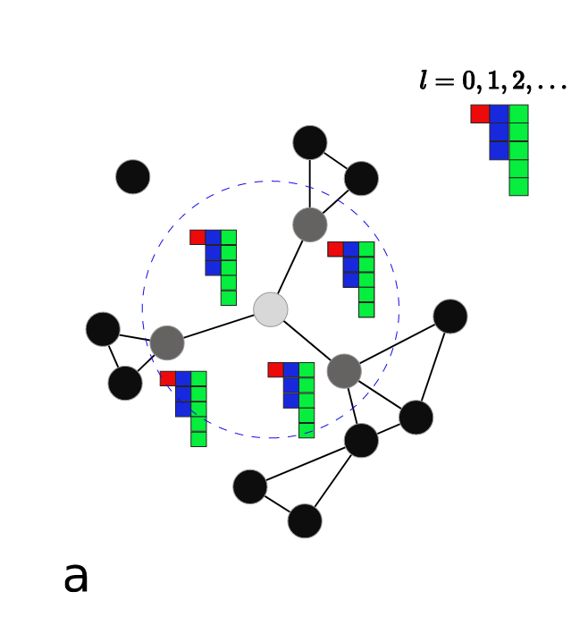
Equivariant Graph Neural Networks
How do equivariant GNNs (NequIP) actually work?

Slide 53
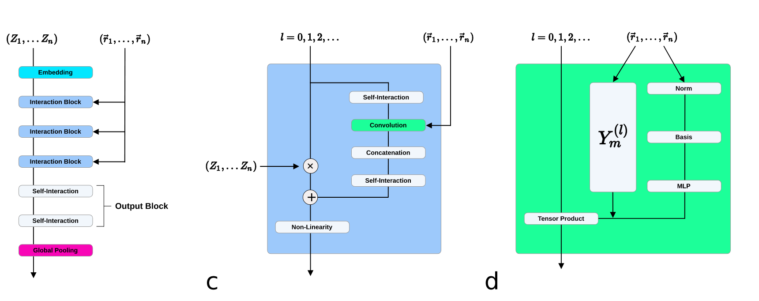
Equivariant Graph Neural Networks
How do equivariant GNNs (NequIP) actually work?

Slide 54
Discussion and Questions?

